Slide 1

AI-Powered Customer Insights: Extract Brand Sentiment from Reviews in Seconds

Slide 2
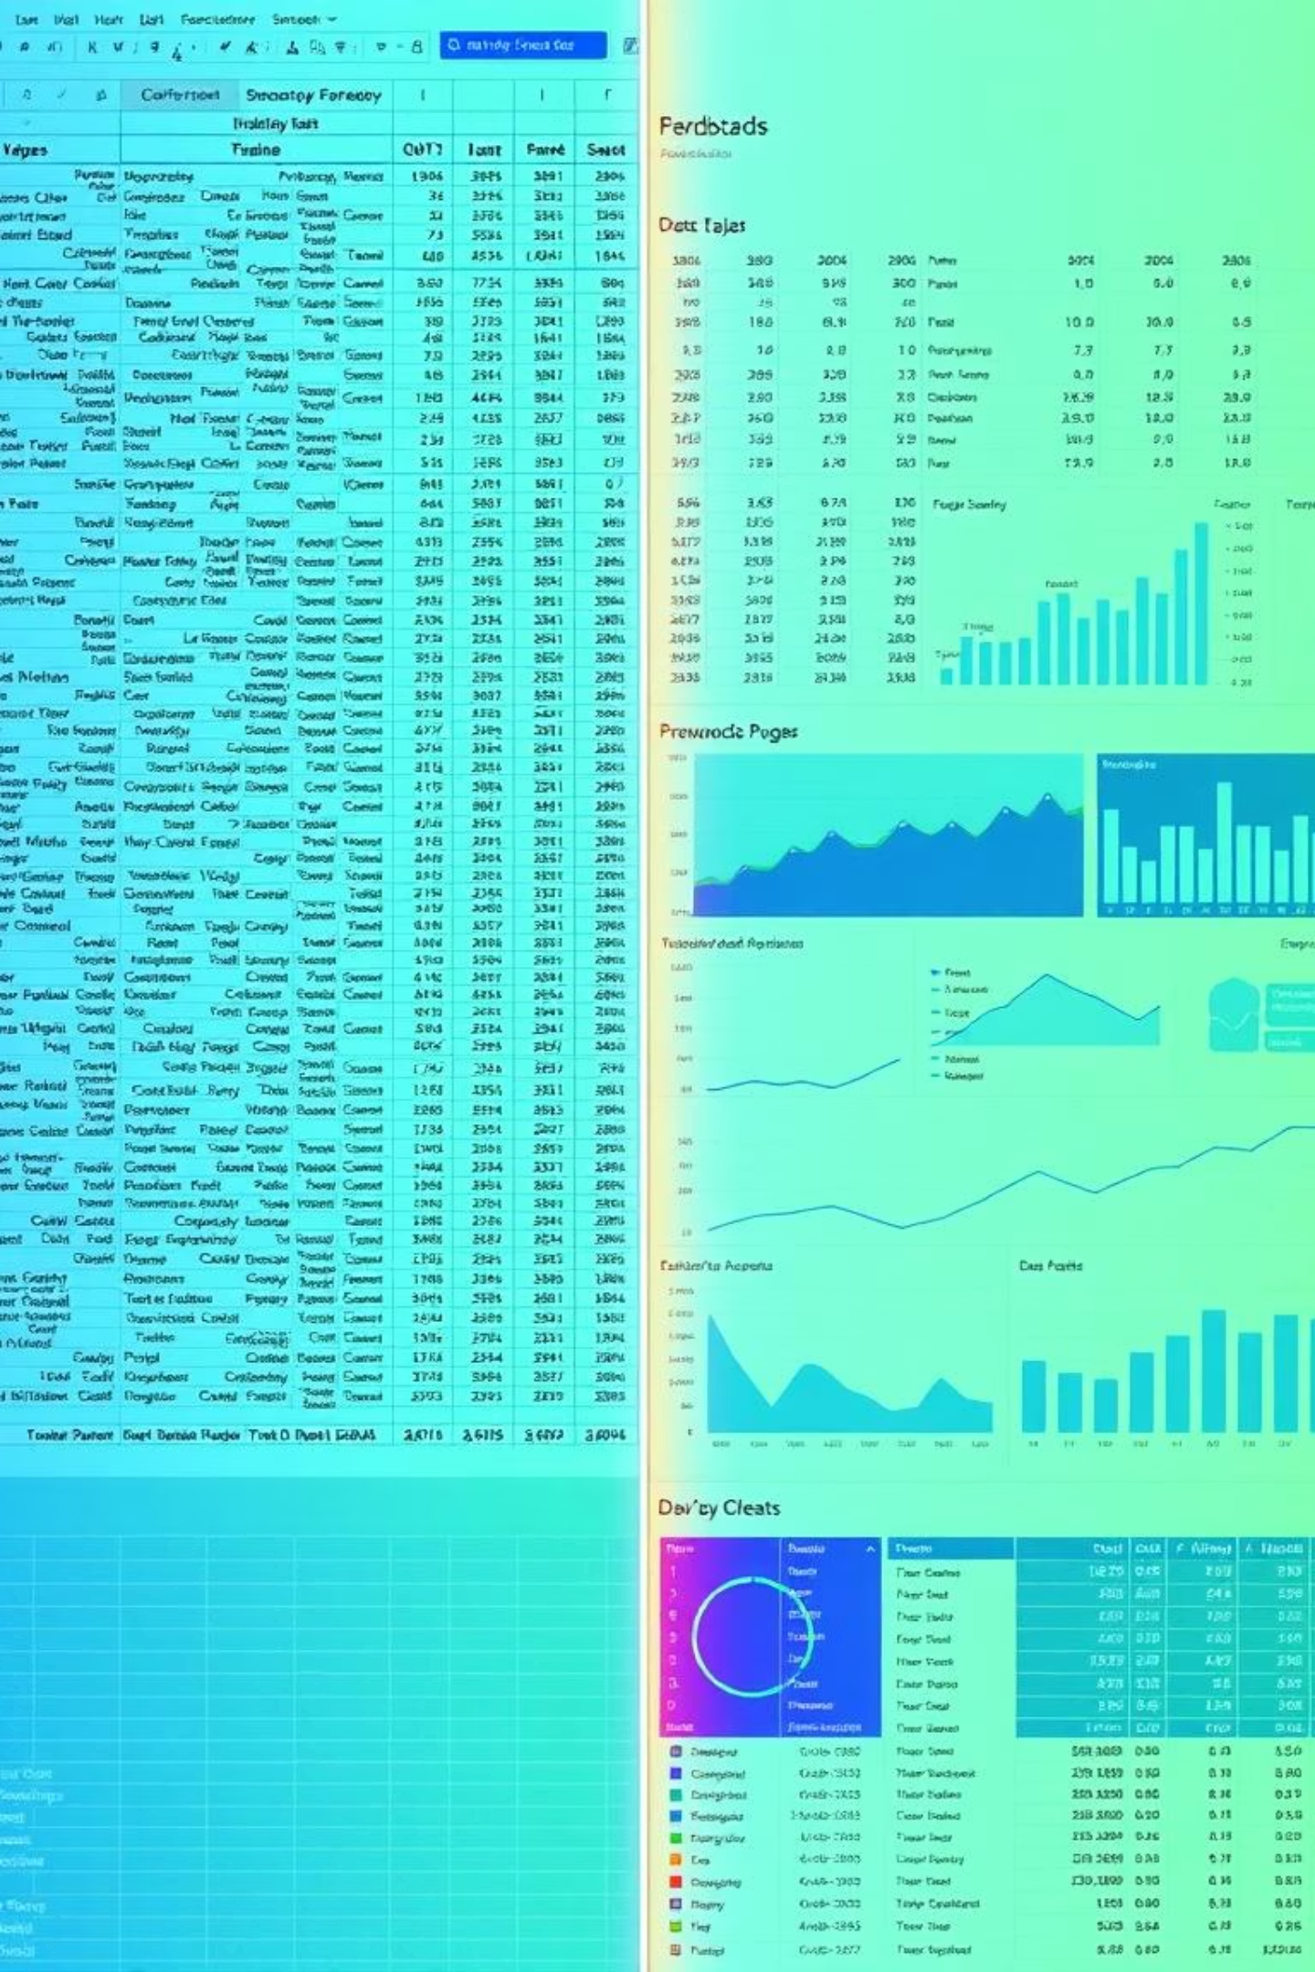



The Hidden Cost of Manual Review Analysis
Missed Brand Mentions
Subjective Interpretation
Time Wastage

Slide 3





Solution Overview: Streamlined Insights
Raw Reviews
NER Processing
Sentiment Analysis
Dashboard Visualization
Auto-Detect Brands/Products
Precise Emotion Scoring
Exportable CSV Reports

Slide 4
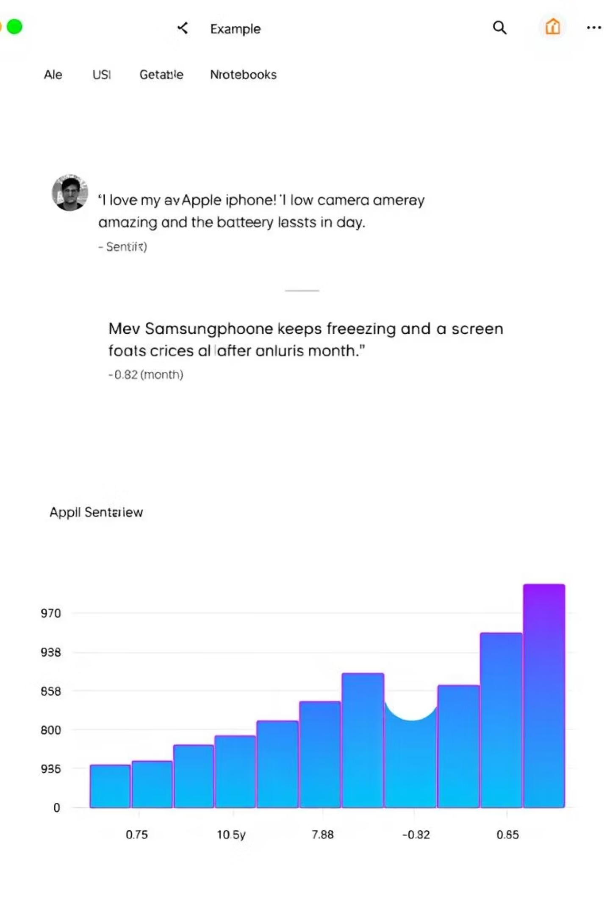
Demo in Action: Review Sentiment Scores
92% positive sentiment for Apple vs. -73% for Samsung in our test data.

Slide 5

Why It Matters: Impactful Business Growth
2.3x
83%
10K
Faster Growth
Trust Reviews
Reviews in Minutes

Slide 6



Key Use Cases Across Departments
Product Teams
Marketing
Executives

Slide 7



Next Steps: Explore and Implement
Ready to transform your customer feedback into actionable intelligence? Explore our tools.
Scan the QR code to access our resources and start your journey to deeper insights.

